Slide 1



Digital Health
UCSD Extension – Specialization Certificate
Data Science for Healthcare
L3: Statistics
Hobson Lane, UC San Diego
Instructor
Notes:
<number>

Slide 2
Agenda
What is statistics and probability?
Descriptive statistics
Probability distributions
Distribution parameters
Prescriptive statistics
Accuracy
Bayes Rule

Slide 3
Statistics
Describe a set of numbers in a dataset
Describe probabilities outside the dataset
Probabilities used to infer properties about the world
Probabilities used to predict the future
Probabilities used to prescribe actions in the world

Slide 4
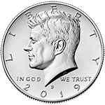
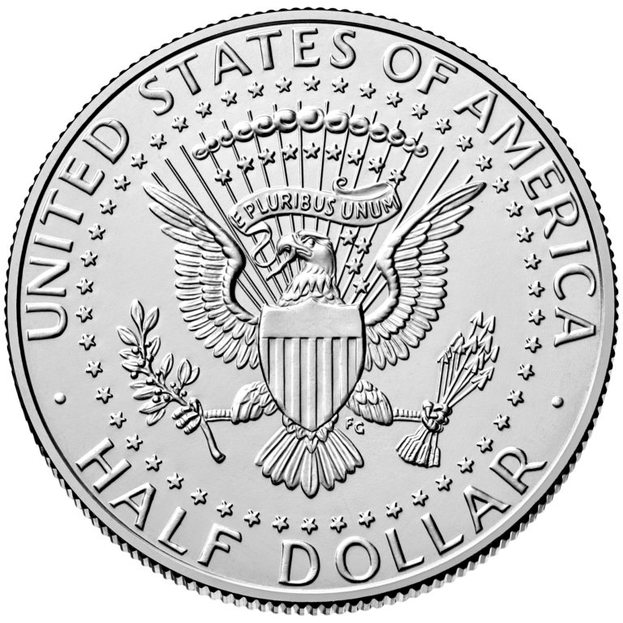
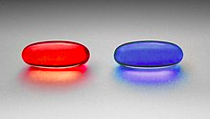
Probability
How often an event will happen among a set of trials
Inherently binary (coin flip)
heads
tails
Probability of Heads
$P\left(H\right)$
Probability of True result
$P\left(T\right)$
True
False
Probability of binary 1
$P\left(1\right)$
1
0
Probability of red pill
$P\left(R\right)$

Slide 5
Binary Probabilities are Complementary
heads
tails
Probability of Heads
$P\left(H\right)=1−P\left(T\right)$
Probability of True
$P\left(T\right)=1−P\left(F\right)$
True
False
Probability of 1
$P\left(1\right)=1−P\left(0\right)$
1
0
Probability of red pill
$P\left(R\right)=1−P\left(B\right)$

Slide 6
Binary = Mutually Exclusive
P(Event) = 1 – P(All other events)
Binary event: only one single alternative event
Probability of Tails
$P\left(T\right)=1−P\left(H\right)$
Probability of False
$P\left(0\right)=1−P\left(1\right)$
False
Probability of Zero
$P\left(F\right)=1−P\left(T\right)$
0
Probability of Blue
$P\left(B\right)=1−P\left(R\right)$

Slide 7
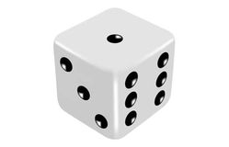
Binary Dice?
Machines “think” and learn in binary logic
Is it a 1?
Is it a 2?
Is it a 3?
Is it a 4?
Is it a 5?
Is it a 6 (six pips up) ?
Presence or absence of a number
1 bit for each number or category
Works even for non numerical (pictograph) dice or loaded dice
0 0 0 0 0 1
0 0 0 1 0 0
1 0 0 0 0 0
One-hot encoding
(used for categorical variables)

Slide 8
Ordinal Dice?
But machines can work with numbers right?
Ordinal encoding
Sides assigned discrete numerical values
Six mutually exclusive discrete values
1
2
3
4
5
6
1
3
6
JUST SAY “NO!”
or “YES!”
but never “2, 3, 4, 5, 6”
Ordinal values

Slide 9
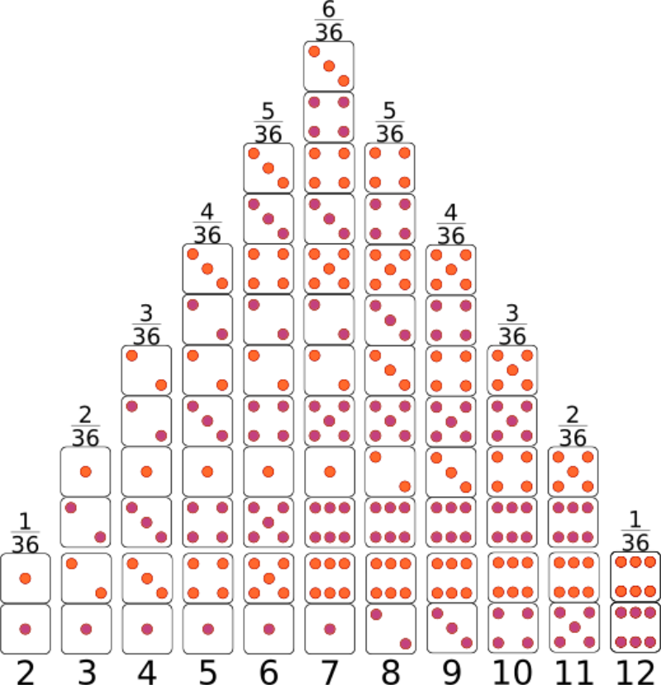
Dice Probability
Die 1 | Die 2 | Sum | P
1 | 1 | 2 | 1/6
1 | 2 | 3 | 1/6
2 | 1 | 3 | 1/6
1 | 3 | 4 | 1/6
$P\left(s=2\right)=P\left(1\right)⋅P\left(1\right)=\frac{1}{36}$
$P\left(3\right)=2⋅P\left(1\right)⋅P\left(2\right)=\frac{2}{36}$
$\frac{1}{6}$
$\frac{1}{6}$
$\frac{1}{6}$
$\frac{1}{6}$
$\frac{1}{6}$
$\frac{1}{6}$
1
2
3
4
5
6
One Die Roll
Sum of Two Die Rolls

Slide 10
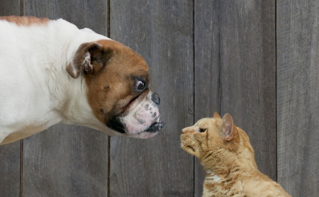
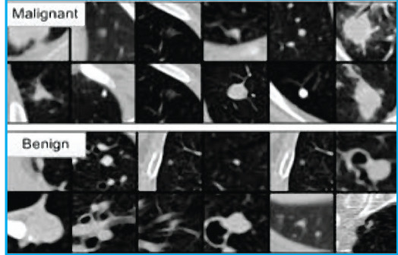
Categorical Probability
Dog? 0 or 1
Cat? 0 or 1
Fox? 0 or 1
Unk? 0 or 1
Thought of as binary
1 bit for each category
Often need “unknown” bit
Probability = confidence
1 =
P(Malignant)
+ P(Benign)
+ P(Healthy)
+ P(Unknown)
Dog? 0 or 1
Cat? 0 or 1
Fox? 0 or 1
Unk? 0 or 1
Malignant?
Benign?
Healthy?
Unknown? (none of the above)

Slide 11
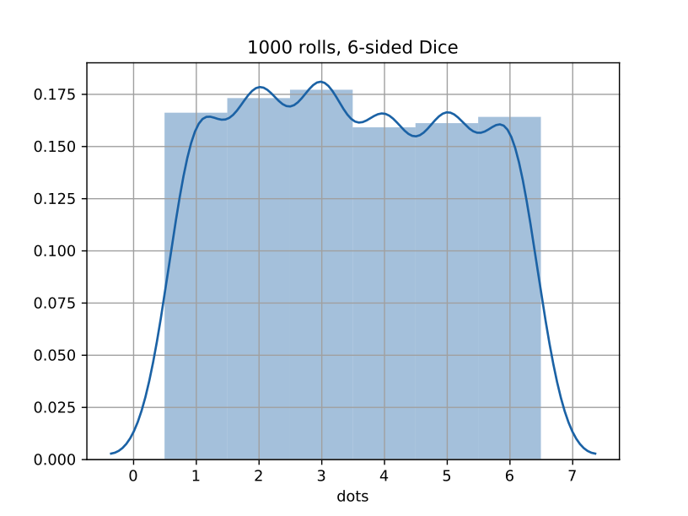
Die Statistics
Min: 1.0
Max: 6.0
Mean: 3.47
Median: 3.0
Mode: 3.0
Midpoint: 3.5
Variance: 2.9
Standard deviation: 1.7
Histogram
sns.distplot()
std()
1.7
std()
1.7
3.5
min()
1.0
max()
6.0

Slide 12
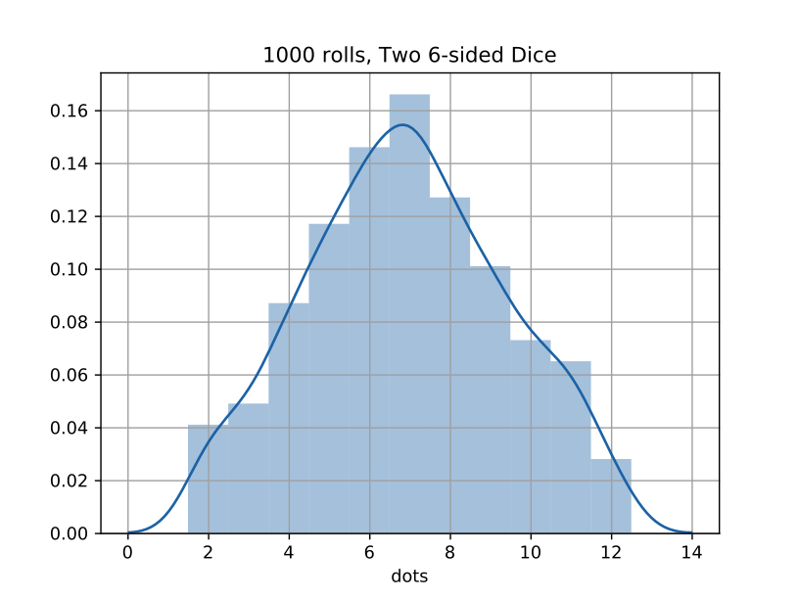
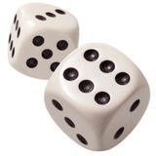
2 Dice Statistics
sns.distplot()
Min: 2.0
Max: 12.0
Mean: 6.9
Median: 7.0
Mode: 7.0
Midpoint: 7.0
Variance: 6.1
Standard deviation: 2.4
Histogram
std()
2.4
std()
2.4
7.0
min()
2.0
max()
12.0

Slide 13
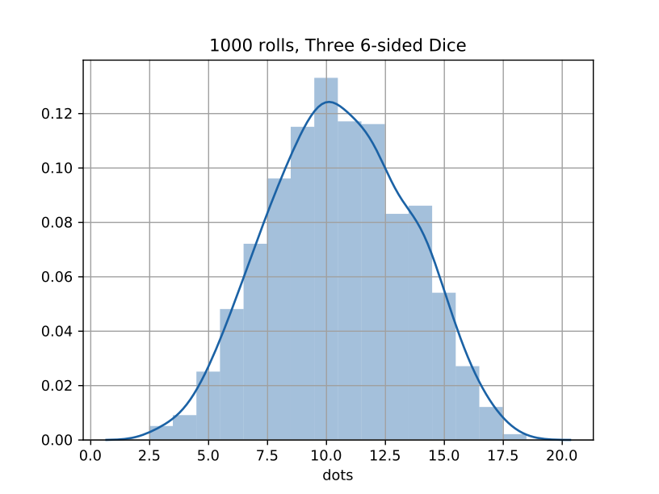
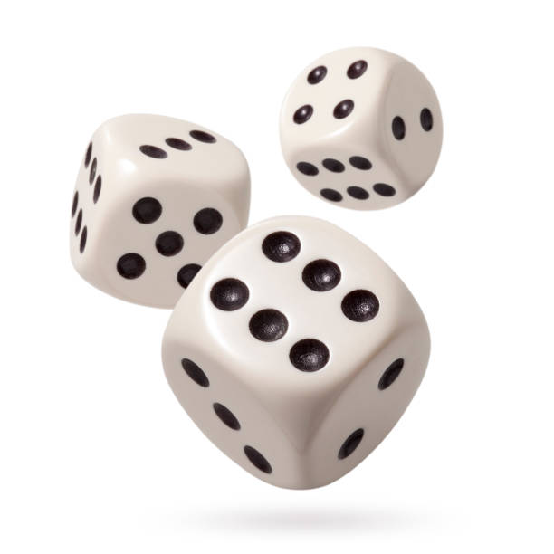
3 Dice Statistics
sns.distplot()
Min: 2.0
Max: 18
Mean: 10.5
Median: 10
Mode: 10.0
Midpoint: 10.5
Variance: 8.6
Standard deviation: 2.9
Histogram
std()
2.9
std()
2.9
10.5
min()
3.0
max()
18.0

Slide 14
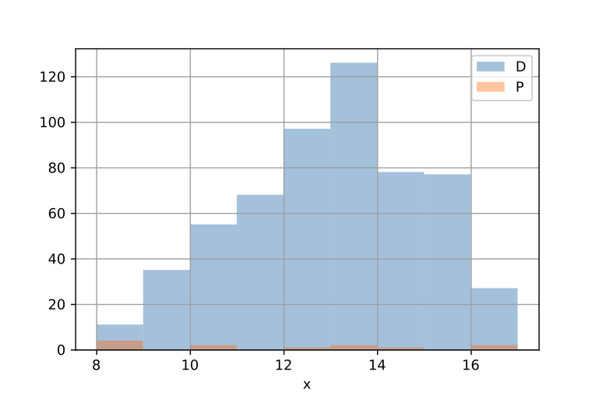
Mystery Dataset
x
count 13.0
mean 12.5
std 3.4
min 8.7
25% 9.0
50% 12.6
75% 14.9
max 18.9
x
count 578.0
mean 13.0
std 2.0
min 8.3
25% 11.6
50% 13.2
75% 14.5
max 17.9
x.hist()
x.min()
x.min()
x.max()

Slide 15
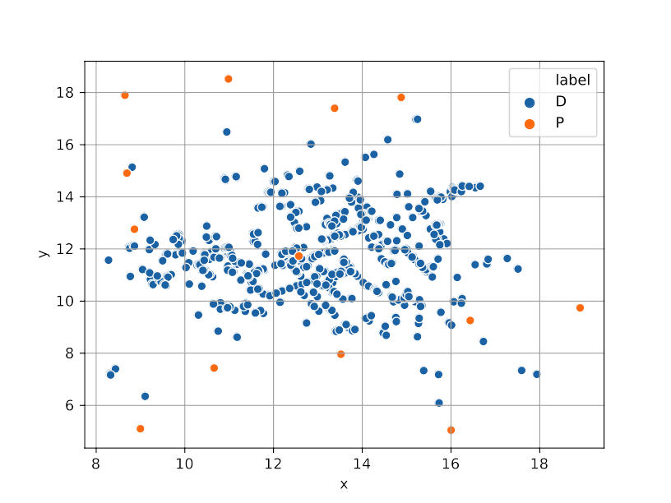
df.describe()
max(df.Y) = 18.5
x y
count 13.0 13.0
mean 12.5 12.0
std 3.4 5.0
min 8.7 5.0
25% 9.0 8.0
50% 12.6 11.7
75% 14.9 17.4
max 18.9 18.5
x y
count 578.0 578.0
mean 13.0 11.7
std 2.0 1.6
min 8.3 6.1
25% 11.6 10.7
50% 13.2 11.5
75% 14.5 12.8
max 17.9 17.0
min(df.Y) = 5.0

Slide 16
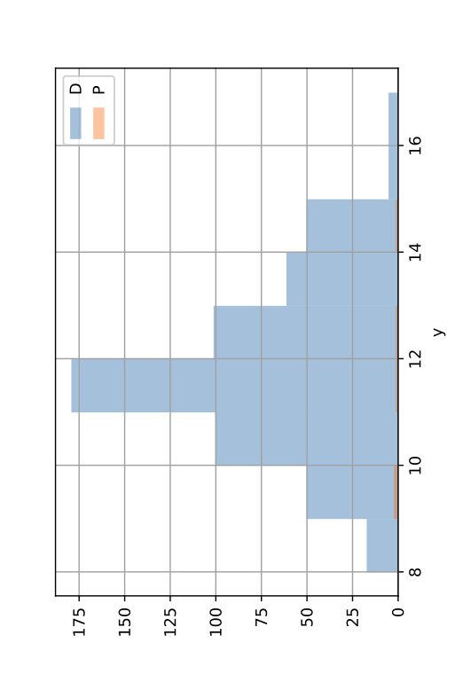
df.hist
y.hist()
mode=11.3
y.mean()
=11.7
x.mean()
=13.0
x y
count 578.0 578.0
mean 13.0 11.7
std 2.0 1.6
min 8.3 6.1
25% 11.6 10.7
50% 13.2 11.5
75% 14.5 12.8
max 17.9 17.0
mode()
(12.7, 11.3)
median()
(13.2, 11.5)
mode=12.7
x.hist()

Slide 17
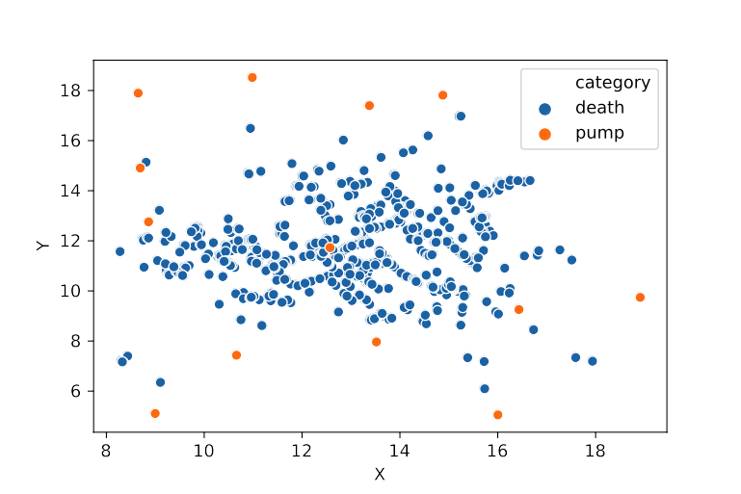
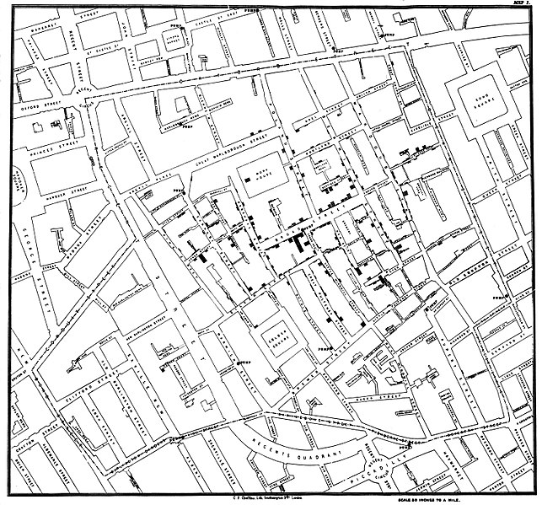
Coordinate Frame (Representation) Matters!
Coordinate frame
Origin (offset)
Orientation
Scale (units)
Filtering
Clipping
Outliers
Smoothing/imputing

Slide 18
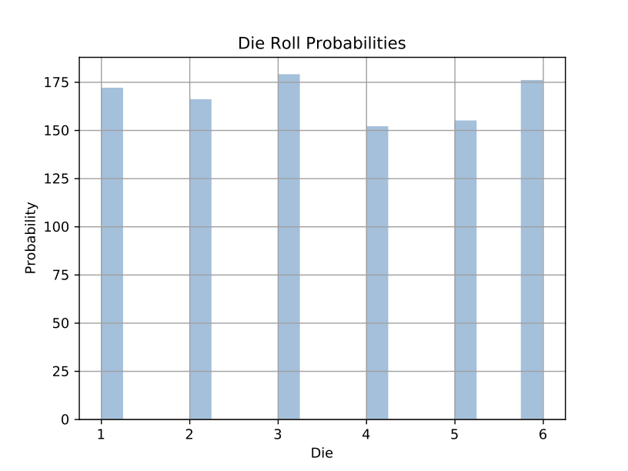
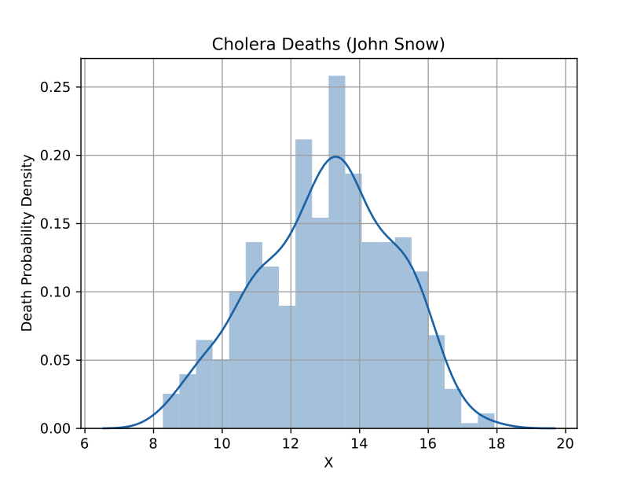
Kinds of Distributions
Discrete probability:
Dice, gender, disease, death, recovery
Distribution (histogram)
Continuous probability:
Height, weight, (x, y) position
Probability density (kernel density)
Conditional probability:
Height based on weight (continuous condition)
Death based on distance (discrete & continuous condition)
2D probability density

Slide 19
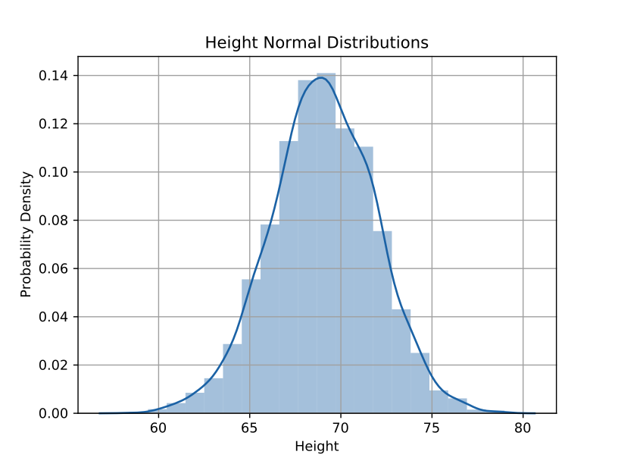
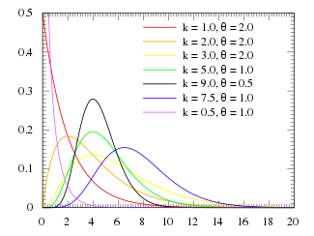
Common Distributions
Uniform
Dice, coin flips, cards
Normal (Gaussian)
Height, weight
Probability density (kernel density)
Gamma (generalized Poisson)
Time between infections, epidemics
Asymmetric distribution

Slide 20
Arithmetic Mean (Average)
$μ=\frac{\sum_{i=0}^{N}{x_{i}}}{N}$
Tyco Brahe, 1587
mean
$μ=\frac{2+3+3+4+...+11+11+12}{36}=7$
# x = [2, 3, 3, 4, 4, 4, 5, 5, 5, 5, … 9, 9, 9, 9, 10, 10, 10, 11, 11, 12]
# x = [die1 + die2 for (die1, die2) in product(range(1, 7), range(1, 7))]
# mu = sum(x) / len(x)
x = [sum(dice) for dice in product([1, 2, 3, 4, 5, 6], [1, 2, 3, 4, 5, 6])])
mu = np.mean(x) # 7

Slide 21
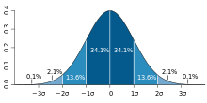
Standard Deviation (and Variance)
Karl Pearson, 1894
$σ^{2}=\sum_{i=0}^{N}{\frac{{\left(x_{i}−μ\right)}^{2}}{N}}$
variance:
$σ=\sqrt{σ^{2}}=\sqrt{\sum_{i=0}^{N}{\frac{{\left(x_{i}−μ\right)}^{2}}{N}}}$
standard deviation:
# sigma = np.sqrt(sum(x**2) / len(x))
sigma = np.std(x) # 2.415...

Slide 22
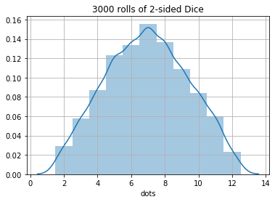
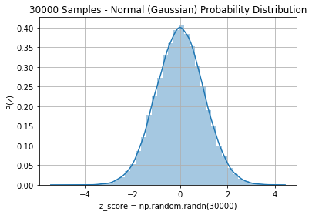
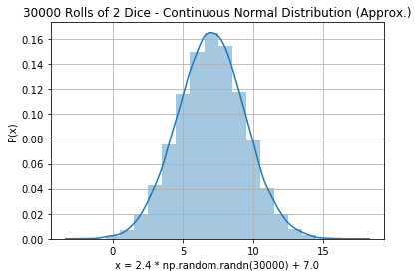
Normal (Gaussian) Distribution
68-95-99.7 rule
std()
2.4
std()
2.4
$1σ=68\text{\%}$
$2σ=95\text{\%}$
$3σ=99.7\text{\%}$
7.0
68%
$±1σ$
16%
16%

Slide 23
Accuracy
Continuous numerical predictions (regression):
How close to correct are your predictions?
RMSE: Root Mean Square Error
$RMSE\left(y,z\right)=\sqrt{\frac{\sum_{i=0}^{N}{{\left(y_{i}−z_{i}\right)}^{2}}}{N}}$

Slide 24
Categorical Accuracy
Categorical predictions (classification):
What proportion of your predictions were correct?
$\frac{N_{correct}}{N_{total}}=\frac{N_{correct}}{N_{correct}+N_{incorrect}}=\frac{TP+TN}{TP+TN+FP+FN}$

Slide 25
Bayes Rule
Updated Probability = Likelihood Ratio * Prior Probability
$P\left(D|T\right)=\frac{P\left(T|D\right)}{P\left(T\right)}⋅P\left(D\right)$
Likelihood Ratio

Slide 26
Bayes Rule Example
Prior | P(D) | Probability of getting breast cancer | 1 in 700 per yr 1 in 70,000 (men)
True Positive Rate (Sensitivity) | P(T|D) | Probability of mammogram detecting cancer | .73
False Positive Rate (False Alarm) | P(T|~D) | Probability of positive mammogram w/o cancer | .12
Positive Rate | P(T) = P(D) * P(T|D) + P(~D) * P(T|~D) | Probability of a positive mammogram among all women | .73 * 1 / 700 + .27 * 699 / 700 = .121

Slide 27
Real Numbers
P(D) | 1/700
P(T|D) | .73
P(T) | .121
$P\left(D|T\right)=\frac{P\left(T|D\right)}{P\left(T\right)}×P\left(D\right)$
$P\left(D|T\right)=\frac{.73}{.121}×\frac{1}{700}=.0086≈1\text{\%}$

Slide 28
What is statistics? How is statistics used in healthcare?

Slide 29
Probability

Slide 30
Conditional Probability

Slide 31
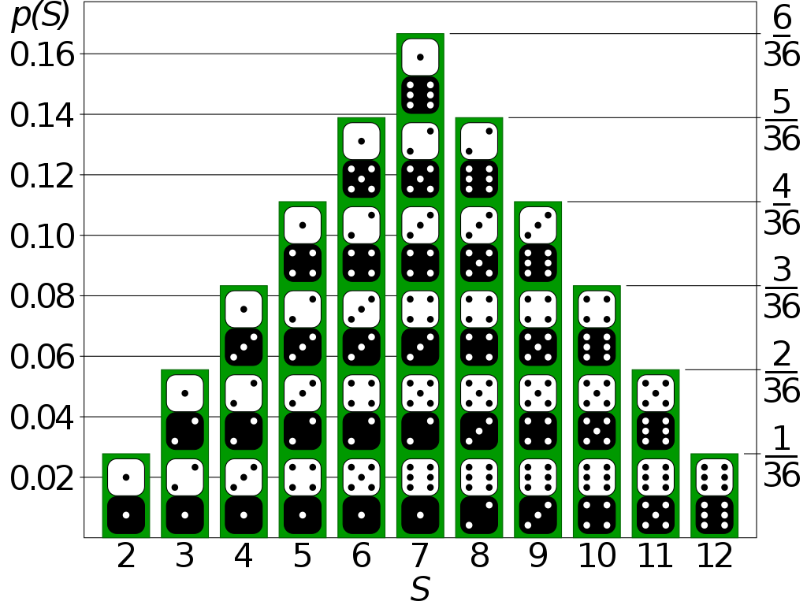
Probability Distribution
Text files (CSV, TSV, JSON, TXT)
Compressed files (ZIP, GZ)
Binary files (XLS, PDF, Images)
Web pages (links to HTML)
Databases

Slide 32
Probability Distribution

Slide 33
PMF: Probability Mass Function (Discrete PDF)

Slide 34
PDF: Probability Density Function

Slide 35
Continuous Probability Distribution

Slide 36
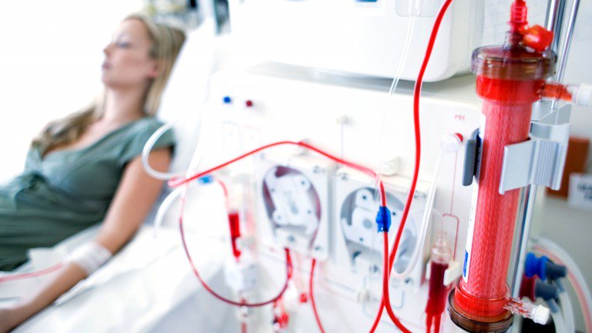
Ethics and Accuracy
Clinical records can predict Kidney failure
2 days in advance
55% accuracy for acute problems
90% accuracy for serious issues
Dataset:
100% UK citizens
100% military
90% male
DeepMind (London)

Slide 37
Berkson’s Paradox
 | General Population |  |  |  | Hospitalization past 6 mo
 | Bone Disease | No Bone Disease | % Bone Disease |  | Bone Disease | No Bone Disease | % Bone Disease
Lung disease | 17 | 207 | 7.6% |  | 5 | 15 | 25.0%
No lung disease | 184 | 2,376 | 7.2% |  | 18 | 219 | 7.6%

Slide 38
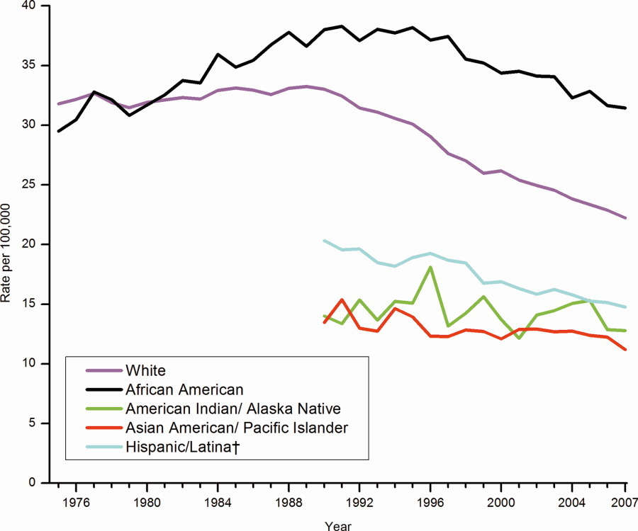
Correlation enables prediction
Breast Cancer Rates 2011: bit.ly/ucsdbreast

Slide 39
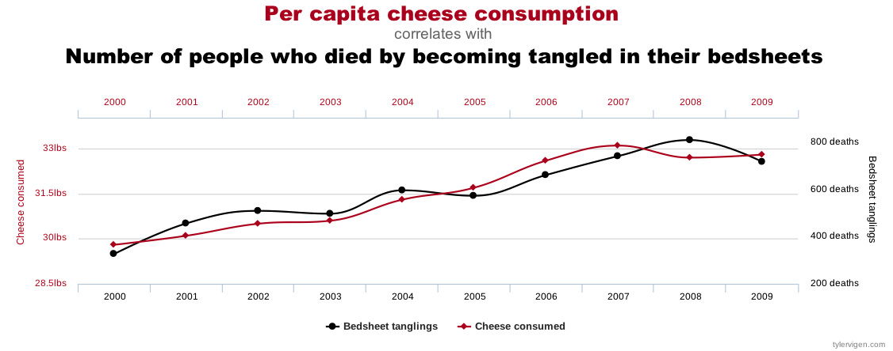
Correlation is not enough
Computers are good at finding patterns
But often those patterns are “spurious correlation”

Slide 40
Bayes Rule
Updated Probability = Likelihood Ratio x Prior Probability
$P\left(D∨T\right)=\frac{P\left(T∨D\right)}{P\left(T\right)}×P\left(D\right)$

Slide 41
Bayes Rule Example
Prior | P(D) | Probability of getting breast cancer | 1 in 700 per yr 1 in 70,000 (men)
Sensitivity | P(T|D) | Probability of mammogram detecting cancer | .73
False Positive Rate (False Alarm) | P(T|~D) | Probability of positive mammogram w/o cancer | .12
 | P(T) = P(D) * P(T|D) + P(~D) * P(T|~D) | Probability of a positive mammogram among all women | .73 * 1 / 700 + .27 * 699 / 700 = .121

Slide 42
Mammograms can cause harm!
P(D) | 1/700
P(T|D) | .73
P(T) | .121
ACP: biannually after age 50+
previously: annual exams at 40+
$P\left(D∨T\right)=\frac{P\left(T∨D\right)}{P\left(T\right)}×P\left(D\right)$
$P\left(D∨T\right)=\frac{.73}{.121}×\frac{1}{700}=.0086≈1\text{\%}$

Slide 43
Assignments

Slide 44
Quiz
Why is understanding Baye’s Rule so important?
Notes:
<number>

Slide 45
Homework: Create diabetes MLE
Download diabetes dataset: http://totalgood.org/midata/...
Notes:
<number>

Slide 46
Project
Use numpy.random.randint() to simulated rolling a pair of dice.
Notes:
<number>

